Slide 1
Restorative Practices In Mediation
Saturday October 1st, 2022
AcIn Mediation training
Sal Corbin, PhD
Notes:
ZOOM logistics
Press record!
Mute everyone as they enter and allow participants to unmute themselves
Give Lia host to enable breakout function
Lia type instructions in zoom for each exercise

Slide 2
So, What are Restorative Practices?
The Foundation of RJ:
https://www.youtube.com/watch?v=gJJxbn1VjYo

Slide 3
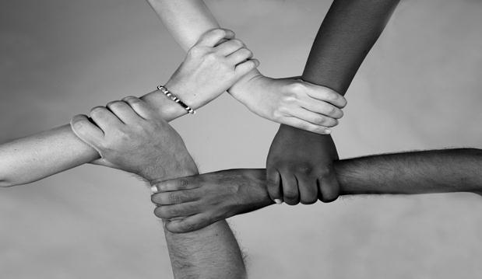
Indigenous Origins

Slide 4
What Makes Restorative Practices “Restorative?” Three Core Assumptions*
2. The needs created by harms lead to obligations.
3. The obligation is to heal and “put right” the harms; this is a just response.
1. When people and relationships are harmed, needs are created.
* Howard Zehr, Criminologist. Northern Virginia Mediation Service (NVMS) Restorative Justice Facilitator Training, 2019.

Slide 5
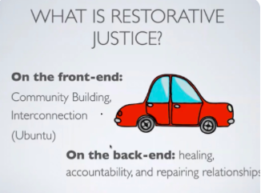
Joe Brummer- https://www.youtube.com/watch?v=2YpoiBAm2Go

Slide 6
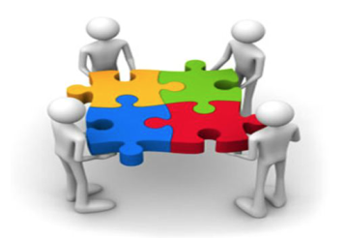
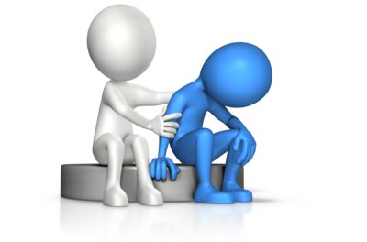
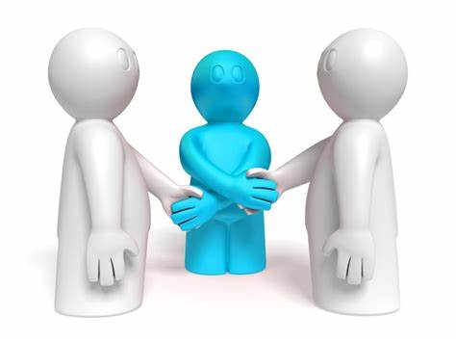
Three Examples of Restorative Practice
Restorative Circles
Restorative Inquiry/Individual Support
Victim-Offender Dialogue

Slide 7
What To Expect
Safe Space
Brave Space
- Safety
- Validation
- Ability to Visit Harm
- Emotional Support
- Vulnerability
- Acknowledging Differences
- Personal Accountability
- Emotional Responsibility
Secure Space

Slide 8
RESTORATIVE INQUIRY (DYADS)
How were you harmed/hurt by the event?
What do you need to overcome that harm/hurt?
What steps can you take (or resources identified) to begin that process today?

Slide 9
THE GUIDING STEPS OF RESTORATIVE MEDIATION
Rebuilding trust is most important!
1. Harm is acknowledged by both parties using active listening. Emotions shared openly.
2. Identify ways to make things right.
3. How to avoid future reoccurrence.
4. Check-in regarding emotions leaving.

Slide 10
ACTIVITY - DYADS
1) Partner 1 think of an experience when they were hurt/harmed i.e. disagreement with someone.
2) Partner 1 shares that experience with partner 2 in detail. Partner 2 doesn’t do anything but listen and affirm.
3) Partner 1 shares that experience again. Partner 2 may ask any questions for clarification.
4) Partner 1 & 2 can discuss event if you have time.

Slide 11
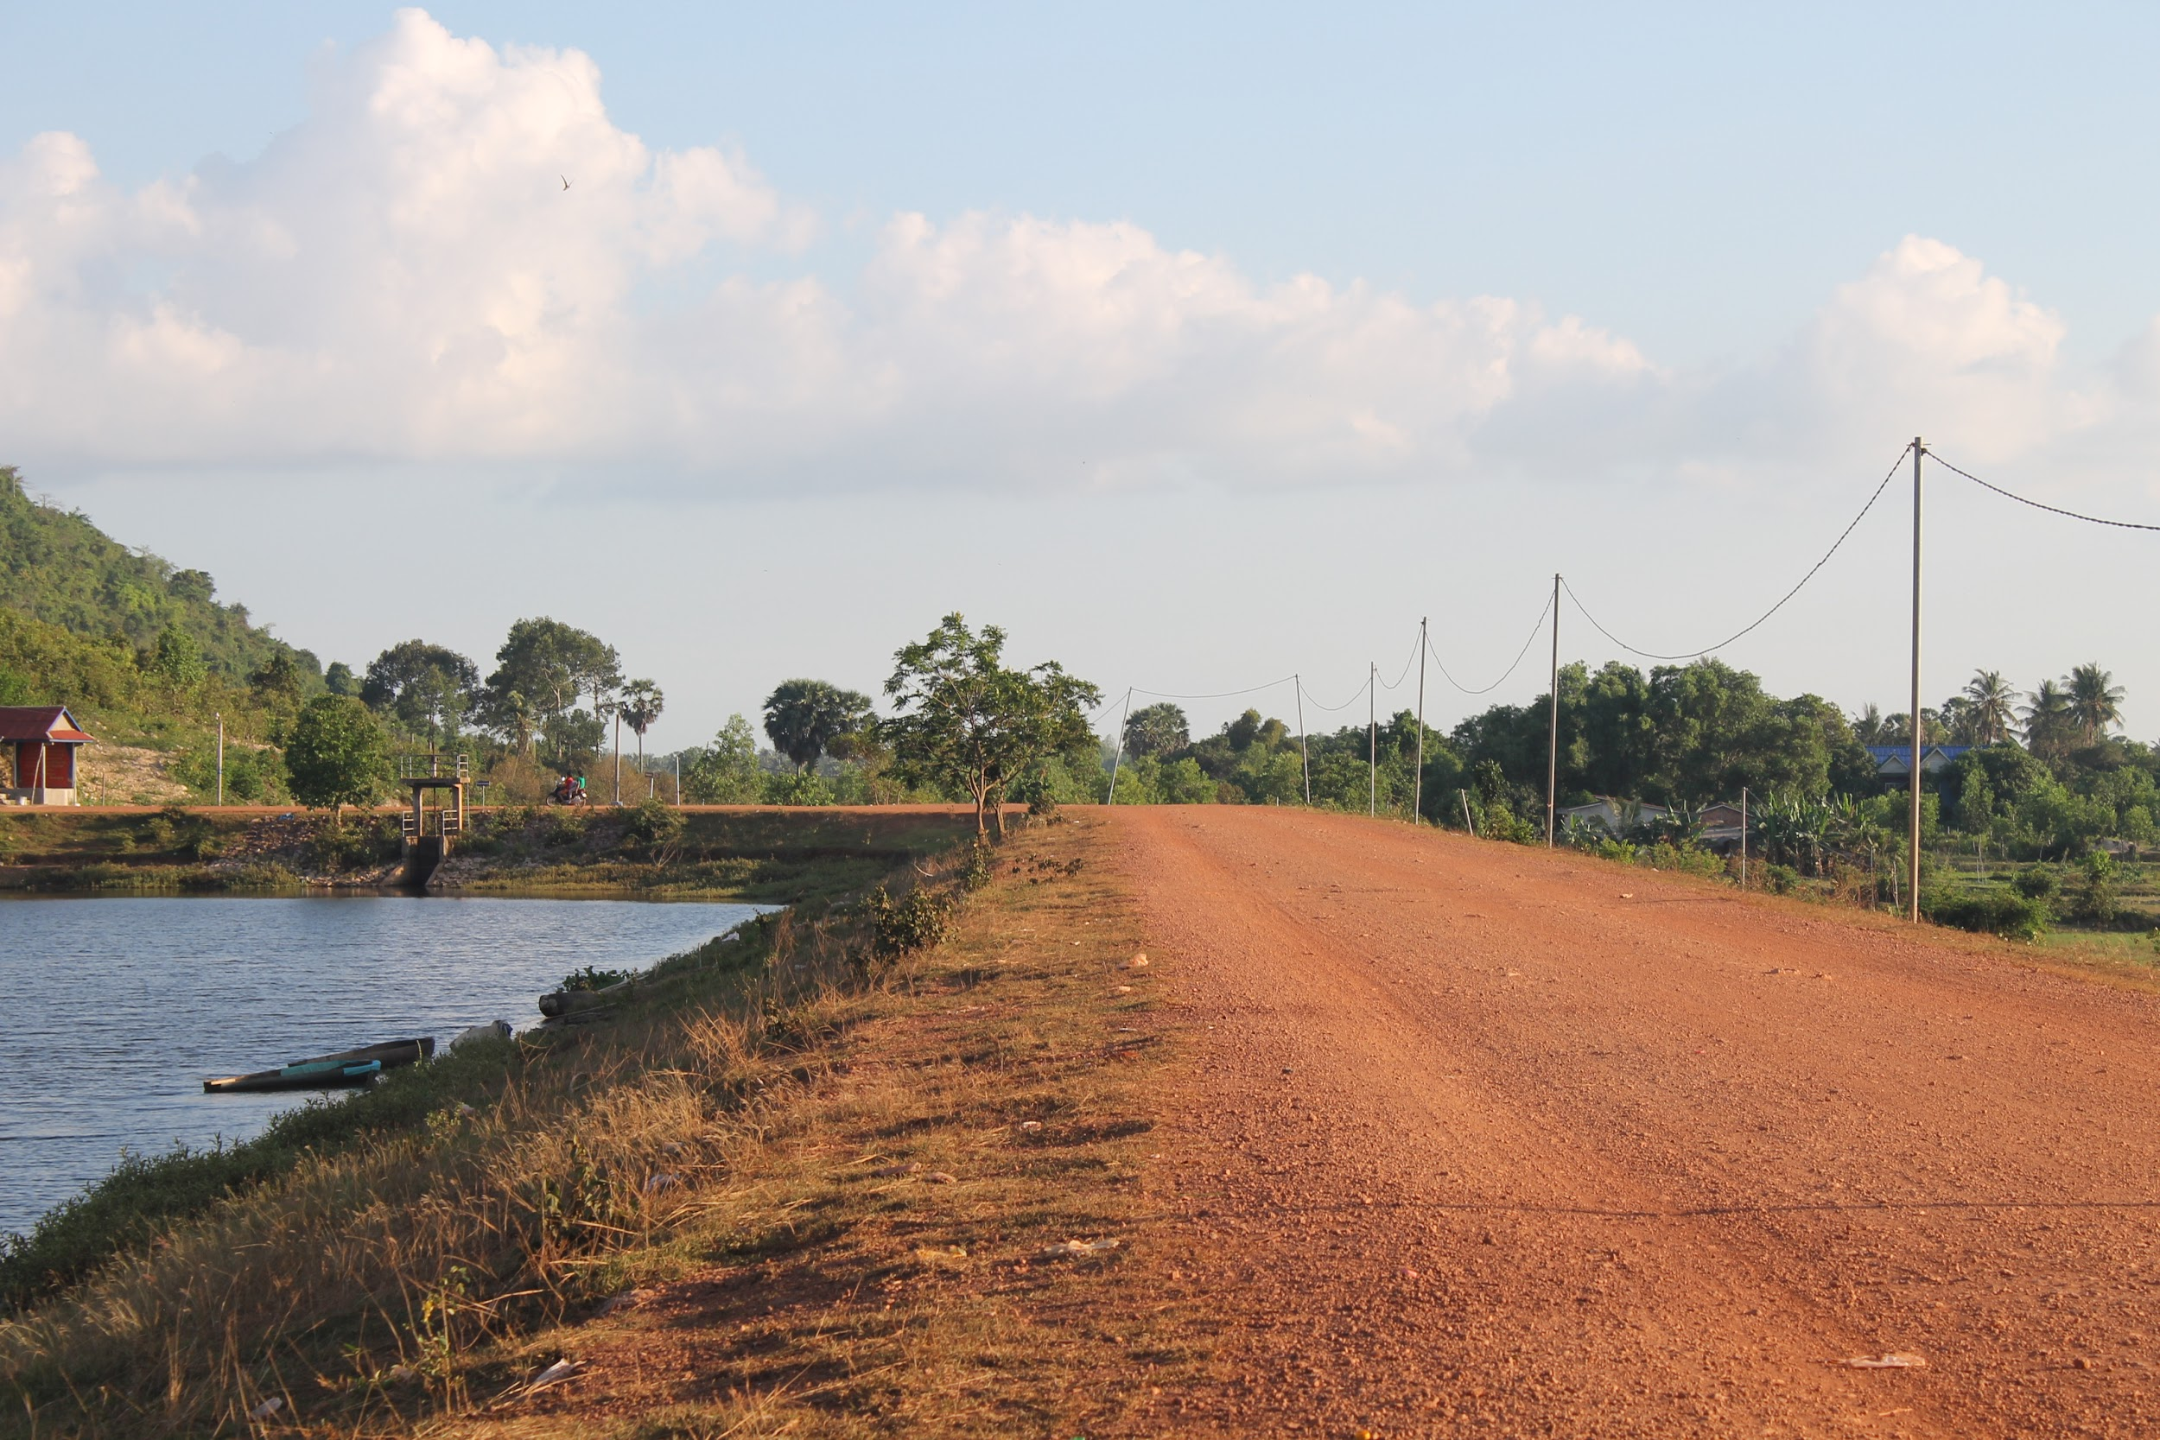
People will forget what you said, people will forget what you did, but people will never forget how you made them feel.

Slide 12
Thank You For Attending!!!
Sal Corbin, Training Coordinator
Sal.corbin@yahoo.com

