Slide 1
Day 3 AcIn Mediation training- Verbal & non-verbal Communication, and body language - Sulekha agarwal

Slide 2
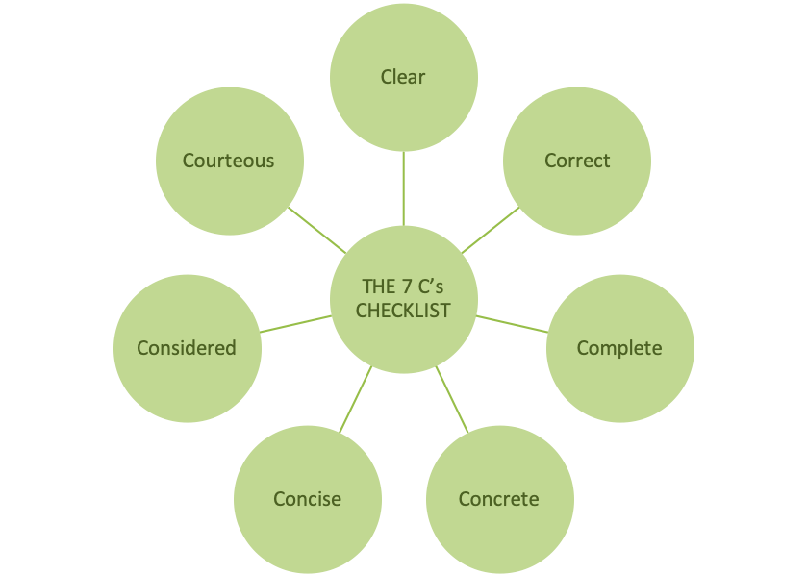
COMMUNICATIONS THEORY 101- BASICS OF VERBAL & NON-VERBAL Communication
What is the communication process?
Communication is a two-way process wherein the message in the form of ideas, thoughts, feelings, opinions is transmitted between two or more persons with the intent of creating a shared understanding.

Slide 3
COMMUNICATIONS THEORY 101- BASICS OF VERBAL & NON-VERBAL Communication
Verbal Communication typically includes communication through words, words are used to convey a symbol- Written & Oral
Non-verbal communication is anything that does not fit into the definition of symbol
Verbal Communication +Non-Verbal Communication = Messages

Slide 4
Non verbal communication
The 55/38/7 Formula
Albert Mehrabian, a researcher of body language, found that communication is 55% nonverbal, 38% vocal, and 7% words only. This is where the idea that the vast majority of communication is nonverbal originated.

Slide 5
Types of Nonverbal Communication
Judee Burgoon (1994) has identified seven different nonverbal dimensions:
Kinesics or body movements including facial expressions and eye contact;
Vocalics or paralanguage that includes volume, rate, pitch, and timbre;
Personal appearance;
Our physical environment and the artifacts or objects that compose it;
Proxemics or personal space;
Haptics or touch;
Chronemics or time.

Slide 6
BODY Language
Be the way that feels most natural to you
Intuition
Do unto others as you would have them do unto you
Specifics for online channels
This Photo by Unknown Author s licensed under CC BY-SA

Slide 7
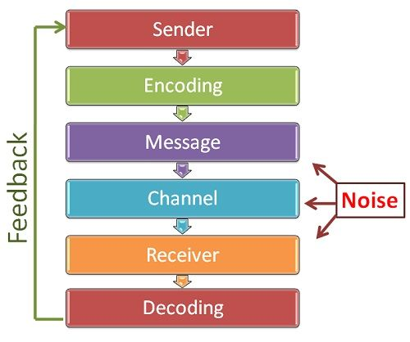
COMMUNICATIONS THEORY 101- BASICS OF VERBAL & NON-VERBAL Communication
THE COMMUNICATION MODEL
More information can be accessed at: https://www.youtube.com/watch?v=-HXa320iTPY

Slide 8
KNOW thyself!
The Myers-Briggs Personality Test https://www.16personalities.com/free-personality-test
"Perception involves all the ways of becoming aware of things, people, happenings, or ideas. Judgment involves all the ways of coming to conclusions about what has been perceived. If people differ systematically in what they perceive and in how they reach conclusions, then it is only reasonable for them to differ correspondingly in their interests, reactions, values, motivations, and skills."

Slide 9
And Your environment!
Reduce Noise
Perspectives
Hear what is not being said

Slide 10
KINDS OF MEDIATION
Facilitative mediation
Evaluative mediation
Transformative mediation
Arb-Med
Med-Arb
Court Mandated
E-mediation
Source: https://www.pon.harvard.edu/daily/mediation/types-mediation-choose-type-best-suited-conflict/

Slide 11
PLAY your way to your style
Game Theory
Poker
Ping Pong
Deal or no Deal
Chess
Monopoly
The Hearts Negotiations Game
The Big Book of Conflict Resolution Games

Slide 12
Learn from others
Books:
Interventions: A Life in War and Peace, Kofi Annan
A Peacekeeper in Africa: Learning from UN Interventions in Other People's Wars , Alan Doss
Letters to a Young Mediator, Rachel Gasser, Julia Palmiano Federer, Matthias Siegfried & Eliane Fitzé (eds.)

Slide 13
Resources
https://www.communicationtheory.org/list-of-theories/
https://www.managementstudyguide.com/communication-theory.htm
https://www.psychologytoday.com/us/blog/beyond-words/201109/is-nonverbal-communication-numbers-game
https://www.nytimes.com/2006/09/24/books/chapters/0924-1st-peas.html
https://www.thoughtco.com/what-is-nonverbal-communication-1691351
https://worldofwork.io/2019/07/the-7-cs-of-communication/

