Slide 2
Mediation
It is a voluntary, party cantered confidential and structured negotiation process where a neutral third party assist in amicable resolving their disputes by using specialized communication and negotiation techniques.

Slide 3
Elements of Mediation
Voluntariness – Parties’ involvement is volitional
- Active and direct participation of parties
- Begins and ends with parties’ consent
- Entails honest engagement

Slide 4
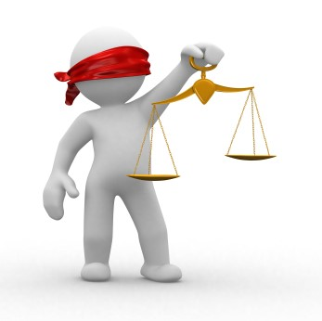
Elements of Mediation
Neutrality and Impartiality –
Favorable behavior to one is unfavorable outcome for all
It is in intertwined in mediator’s role
Reflected in the actions and behavior of mediator
Bedrock of a successful mediation
Vital to ensure parties’ trust in the mediation process

Slide 5
Elements of Mediation
Confidentiality – Secret to success
Facilitates disclosures
Acclimates environment for divulgence of sensitive information
Induces fearless participation in private session
Distinctive characteristic

Slide 6
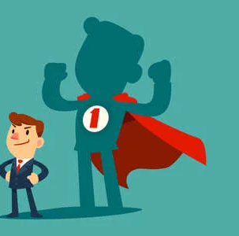
Elements of Mediation
Self Determination –
Resolution on one’s own accord
Chief differentiating characteristic
Parties are focal points
Make free and informed choices
Promotes dignity

Slide 7
What isn’t mediation?
Arbitration
Litigation
Counselling
Forum for information gathering
Meditation

