Slide 1
Handling Emotions

Slide 2
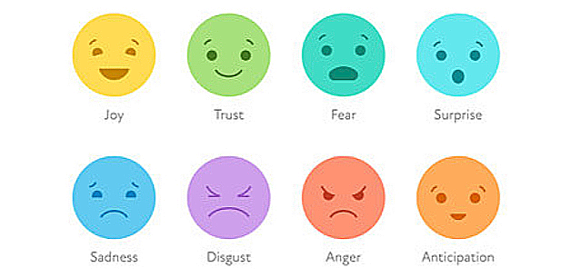
Basic Emotions

Slide 3
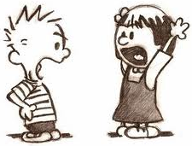
IMPACT OF EMOTION IN CONFLICT
Escalate and cause conflict
Aids in dispute resolution
It shapes decision making process
Emotional satisfaction brings collaborative rational settlement

Slide 4
EMOTIONAL INTELLIGENCE

Slide 5
Emotional Intelligence
An ability to understand and manage your own emotions and those of the people around you.

Slide 6
Elements of Emotion Intelligence (Daniel Goleman)
Self Awareness
Self Regulation
Motivation
Empathy
Social Skill

Slide 7
Emotions
Feelings
Behavior
Communication
Decision-making

Slide 8
Mediators Embracing the Power of Emotions
Recognize emotional blocks
Balance emotional environment
Recognize emotion as opportunity
Encourage expression of emotions
Ease the emotional state of participants
Acknowledge emotions & understand their source

Slide 9
TECHNIQUES TO HANDLE EMOTIONS
Cultivate environment of trust
Empathetic Listening
Relaxation Techniques
Communication skills
Cognitive restructuring
Emotional reappraising

