Slide 1
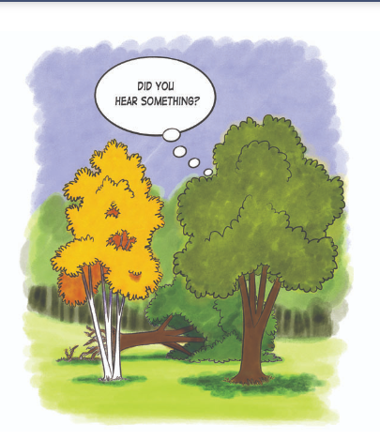
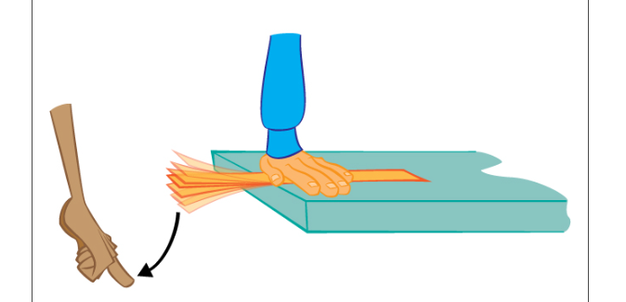
Active Listening
If a tree falls in a forest, and there’s no one around to hear it, does it make a sound?
Vibrations?
Only when someone hears

Slide 2
Active Listening is key to a successful mediation

Slide 3
What is Active Listening?
Choose to be fully present in the conversation
mindful choice not to give in to distraction.

Slide 4
What is Active Listening?
Choose to be fully present in the conversation
Avoiding the temptation to be formulating our response
mindful choice not to give in to distraction.
Instead, use that extra mental energy to read between the lines.

Slide 5
What is Active Listening?
Choose to be fully present in the conversation
Avoiding the temptation to be formulating our response
Aspire to deep listening
mindful choice not to give in to distraction.
Instead, use that extra mental energy to read between the lines.
When we listen deeply, we do so without judgment or preconceived ideas.

Slide 6
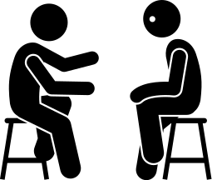
What is Active Listening?
Choose to be fully present in the conversation
Avoiding the temptation to be formulating our response
Aspire to deep listening
mindful choice not to give in to distraction.
Instead, use that extra mental energy to read between the lines.
When we listen deeply, we do so without judgment or preconceived ideas.
Respond mindfully
our intent is to explore the other person’s point of view and not impose our own agenda.

Slide 7
What is Active Listening?
Choose to be fully present in the conversation
Avoiding the temptation to be formulating our response
Aspire to deep listening
mindful choice not to give in to distraction.
Instead, use that extra mental energy to read between the lines.
When we listen deeply, we do so without judgment or preconceived ideas.
Respond mindfully
Be self-aware
our intent is to explore the other person’s point of view and not impose our own agenda.
“A clouded mirror cannot reflect accurately. We cannot perceive, receive, or interact authentically with others unless our self-relationship is authentic”

Slide 8
What is Active Listening?
Choose to be fully present in the conversation
Avoiding the temptation to be formulating our response
Aspire to deep listening
mindful choice not to give in to distraction.
Instead, use that extra mental energy to read between the lines.
When we listen deeply, we do so without judgment or preconceived ideas.
Respond mindfully
Be self-aware
Listening to the Listener
our intent is to explore the other person’s point of view and not impose our own agenda.
“A clouded mirror cannot reflect accurately. We cannot perceive, receive, or interact authentically with others unless our self-relationship is authentic”
Active listening focused on the listener’s interpretation, and the use of “open‐ended curious questions” to see if the interpretation concurs with what the speaker intended to say.

Slide 9
Active Listening Activity

